Slide 1

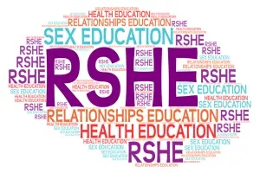
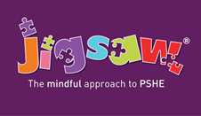
Highlees Primary School
Parent information for the
RSHE curriculum

Slide 2

Highlees Primary School
The Health Education and Relationships Education aspects of PSHE (personal, social, health education) will be compulsory in all primary schools from summer term 2021 (latest September 2021). This is known as RSHE (Relationship, sex and health education).
This covers broad areas of particular relevance and concern to children and young people today. It should ensure that every child is guaranteed a PSHE education that covers mental health and wellbeing, physical health (including healthy lifestyles and first aid) and learning about safe, healthy relationships, including understanding consent and negotiating life online.
These new statutory requirements do not extend to sex education at KS1 and 2 (beyond the biological and reproductive aspects schools are already required to cover in science)
However the Department for Education ‘continues to recommend that all primary schools should have a sex education programme tailored to the age and the physical and emotional maturity of the pupils’

Slide 3
Highlees Primary School
Science & Sex Education in KS1
identify, name, draw and label the basic parts of the human body and say which part of the body is associated with each sense
notice that animals, including humans, have offspring which grow into adults
Science & Sex Education in KS2
describe the differences in the life cycles of a mammal, an amphibian, an insect and a bird
describe the life process of reproduction in some plants and animals
describe the changes as humans develop to old age
learn about the changes experienced in puberty

Slide 4
What is covered in Relationships Education?
Relationships Education in primary schools will protect children.
The new Government guidance sets out the content under the following headings: ‘Families and people who care for me’, ‘Caring friendships’, ‘Respectful relationships’, ‘Online relationships’, ‘Being safe’.
There is widespread agreement that children need to be able to recognise abusive behaviour and to know how to seek help if they are worried about abuse or experience it. The new guidance states that by the end of primary school all children should know: ‘how to report concerns or abuse, and the vocabulary and confidence needed to do so’.
RSHE at Highlees aims to put in place the building blocks needed for positive and safe relationships of all kinds. This will start with family and friends, how to treat each other with kindness, and recognising the difference between online and offline friendships.
The new Government guidance is compatible with the Equalities Act 2010 – “Relationships Education should promote equal, safe and enjoyable relationships and be taught in a way which fosters LGBT and gender equality” – The Sex Education Forum.

Slide 5
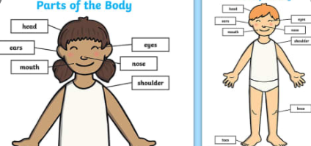
What is covered in RSHE in EYFS?
In our Early Years Classes the children will be taught;
I can name parts of the body.
I can tell you some things I can do and foods I can eat to be healthy.
I understand that we all grow from babies to adults.
I can express how I feel about moving to Year 1.
I can talk about my worries and/or the things I am looking forward to about being in Year 1.
I can share my memories of the best bits of this year in Reception.

Slide 6
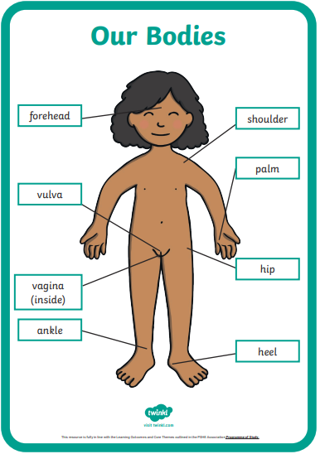
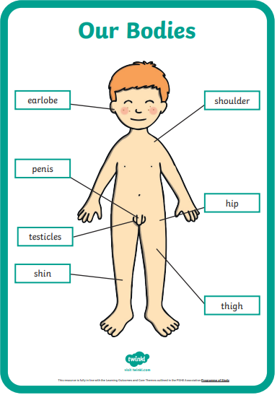
What is covered in RSHE in Year 1?
In our Year 1 Classes the children will be taught;
I am starting to understand the life cycles of animals and humans.
I can tell you some things about me that have changed and some things about me that have stayed the same.
I can tell you how my body has changed since I was a baby.
I can identify the parts of the body that make boys different to girls and can use the correct names for these: penis, testicles, vagina, vulva, and anus.
I understand that every time I learn something new I change a little bit.
I can tell you about changes that have happened in my life.

Slide 7
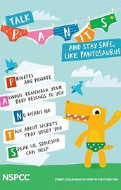
What is covered in RSHE in Year 2?
In our Year 2 Classes the children will be taught;
I can recognise cycles of life in nature.
I can tell you about the natural process of growing from young to old and understand that this is not in my control.
I can recognise how my body has changed since I was a baby and where I am on the continuum from young to old.
I can recognise the physical differences between boys and girls, use the correct names for parts of the body (penis, anus, testicles, vagina, vulva) and appreciate that some parts of my body are private.
I understand there are different types of touch and can tell you which ones I like and don’t like.
I can identify what I am looking forward to when I move to my next class.

Slide 8
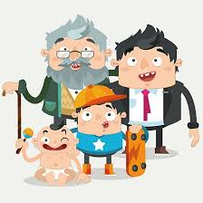
What is covered in RSHE in Year 3?
In our Year 3 Classes the children will be taught;
I understand that in animals and humans lots of changes happen between conception and growing up, and that usually it is the female who has the baby.
I understand how babies grow and develop in the mother’s uterus. I understand what a baby needs to live and grow.
I understand that boys’ and girls’ bodies need to change so that when they grow up their bodies can make babies.
I can identify how boys’ and girls’ bodies change on the inside during the growing up process and can tell you why these changes are necessary so that their bodies can make babies when they grow up.
I can start to recognise stereotypical ideas I might have about parenting and family roles.
I can identify what I am looking forward to when I move to my next class.

Slide 9
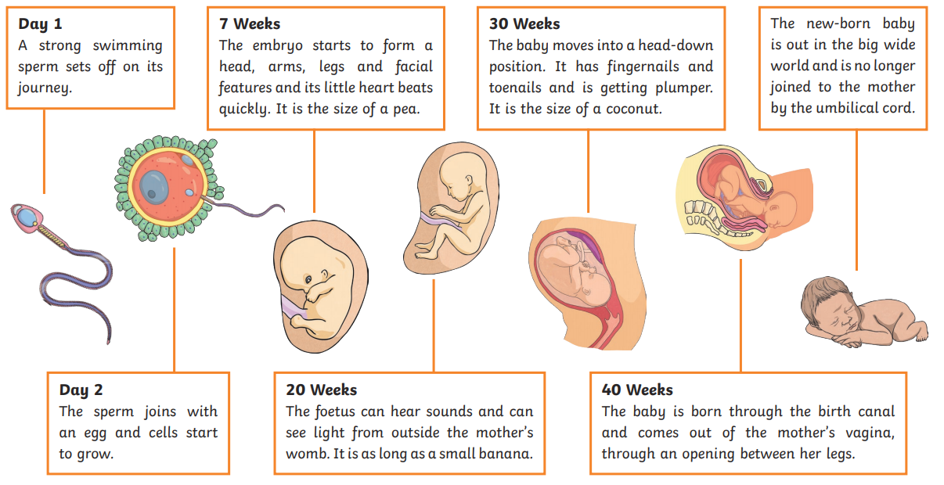
What is covered in RSHE in Year 4 ?
In our Year 4 Classes the children will be taught;
I understand that some of my personal characteristics have come from my birth parents and that this happens because I am made from the joining of their egg and sperm.
I can correctly label the internal and external parts of male and female bodies that are necessary for making a baby.
I know how the circle of change works and can apply it to changes I want to make in my life.
I can identify changes that have been and may continue to be outside of my control that I learnt to accept.
I can identify what I am looking forward to when I move to a new class

Slide 10
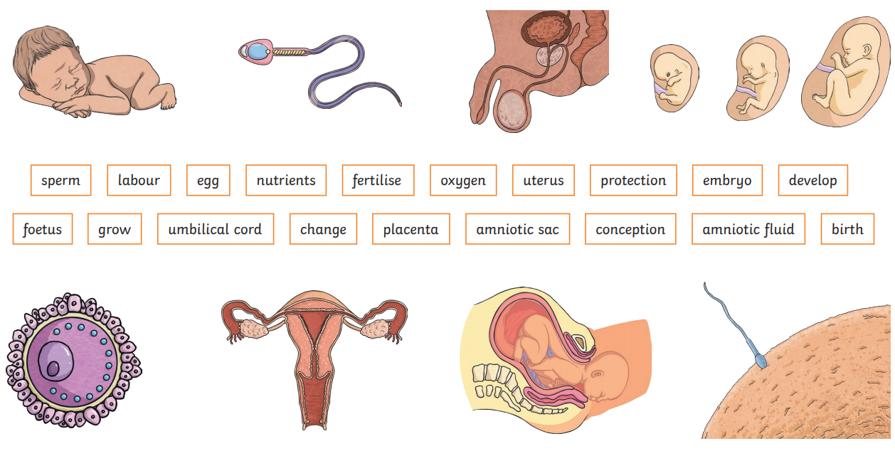
What is covered in RSHE in Year 5?
In our Year 5 Classes the children will be taught;
I am aware of my own self-image and how my body image fits into that.
I can explain how a girl’s body changes during puberty and understand the importance of looking after yourself physically and emotionally.
I understand that sexual intercourse can lead to conception and that is how babies are usually made. I also understand that sometimes people need IVF to help them have a baby.
I can identify what I am looking forward to about becoming a teenager and understand this brings growing responsibilities (age of consent).
I can identify what I am looking forward to when I move to my next class.

Slide 11
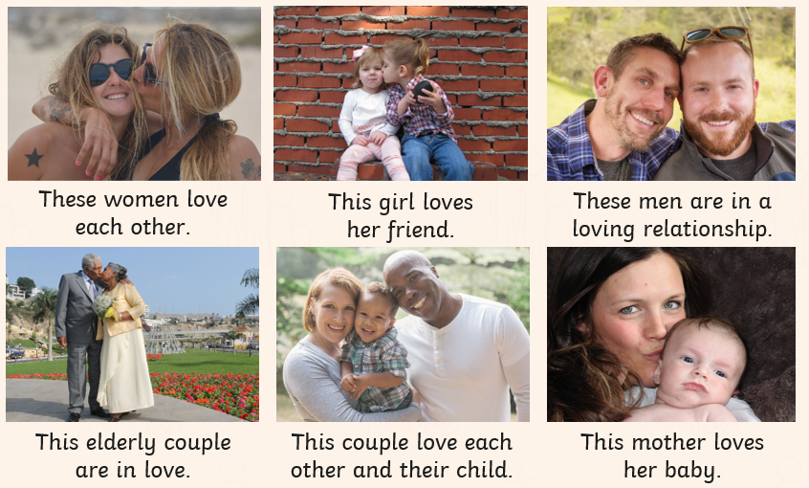
What is covered in RSHE in Year 6 ?
In our Year 6 Classes the children will be taught;
I am aware of my own self-image and how my body image fits into that.
I can explain how girls’ and boys’ bodies change during puberty and understand the importance of looking after yourself physically and emotionally.
I can describe how a baby develops from conception through the nine months of pregnancy, and how it is born.
I understand how being physically attracted to someone changes the nature of the relationship and what that might mean about having a girlfriend/boyfriend.
I am aware of the importance of a positive self-esteem and what I can do to develop it.
I can identify what I am looking forward to and what worries me about the transition to secondary school /or moving to my next class.

Slide 12

Highlees Primary School
If you have any concerns about the coverage of the RSHE curriculum at Highlees Primary School, then please contact the school office to arrange a time to speak to Miss Cooper, Mrs Boothdale (PSHE/RSHE Lead) or Mrs Albert, and we will happily talk about this with you.

