Slide 1

Class Curriculum Information
CLASS NOTICES
Reading
Please remember to share your child’s book with them at home. Encourage them to talk about what they think is happening in the pictures and look out for any sounds that they have learnt. Please then write a short comment in their reading record so that we can change books. Remember to bring books in on a Wednesday.
PE.
PE will still take place on a Tuesday. Children will still come to school in their kit on PE days. They will be wearing this kit outside at lunch and playtimes so please ensure it is weather appropriate.
Welly Walks
Children take part in weekly welly walk sessions. Please ensure wellington boots are kept in school.
Homework
Please remember to look at your child’s tapestry account. Each week there is information about what your child is learning in school. We would love to see some photos of things your child has done at home e.g. learning phonics sounds, reading or something which they would like to share in school.
EYFS
Autumn Term 2
2025
Being Me in Our Wonderful World- Amazing Autumn

Slide 2
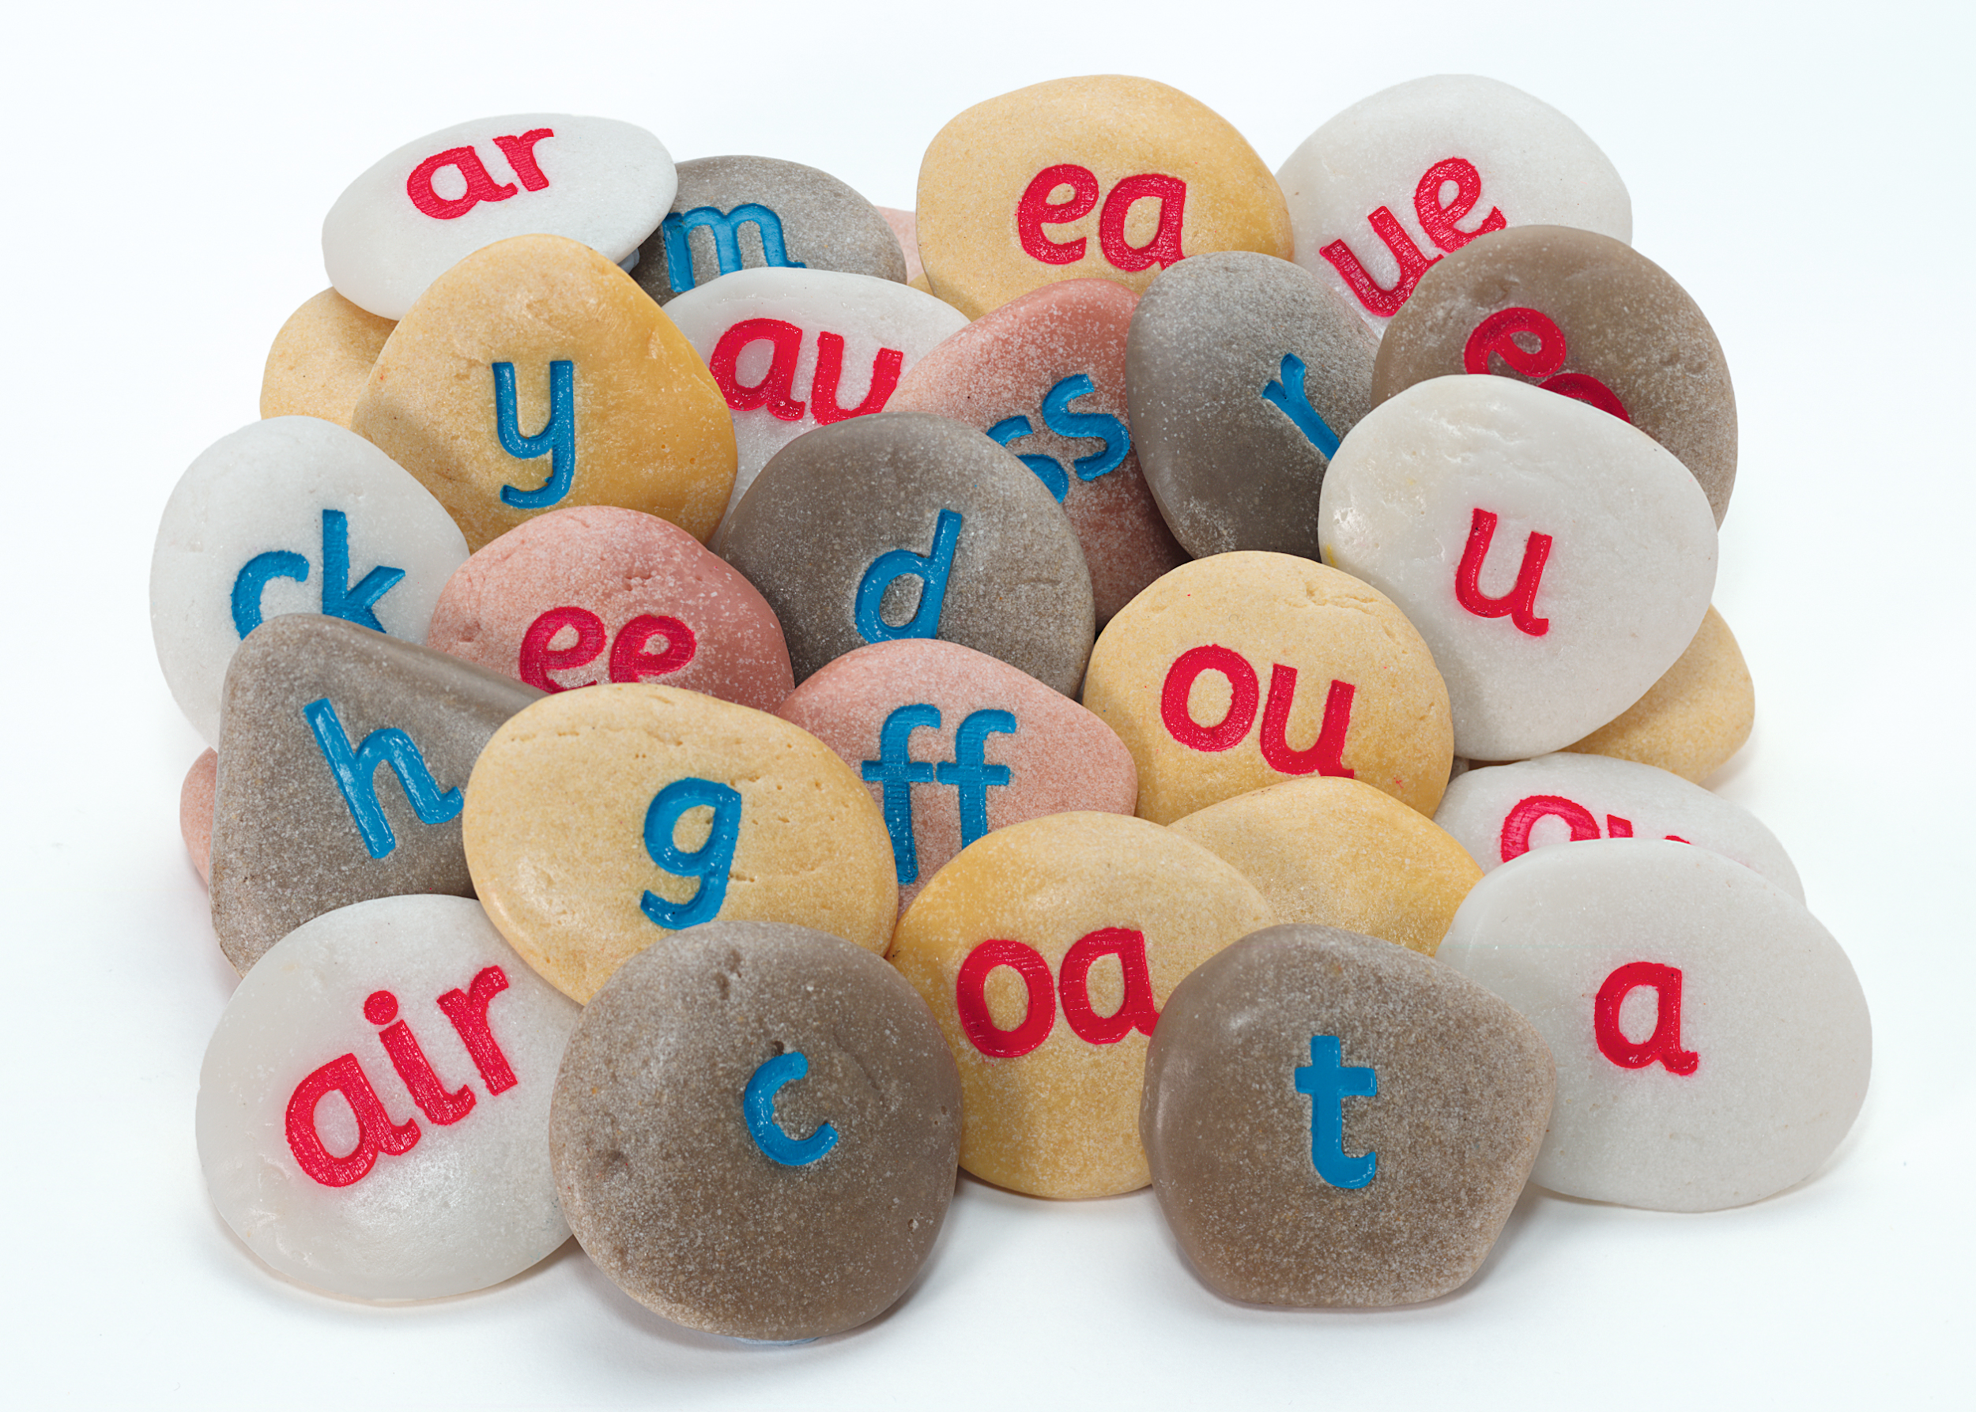
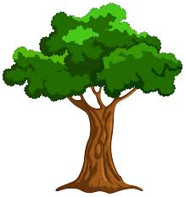



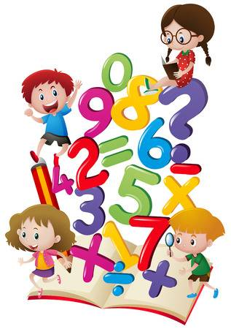
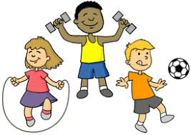
ENRICHMENT AREAS OF LEARNING
ENRICHMENT AREAS OF LEARNING
Phonics | In our phonics lessons we will finish phase 2 and begin to learn phase 3 sounds and tricky words. We have a writing table and book corner and lots of writing opportunities both indoors and outdoors to encourage the children to read and write independently.
Literacy | In Literacy we will be exploring a range of texts linked to our ‘Amazing Autumn’ topic. We will look at the texts ‘Pumpkin Soup’ and ‘Owl Babies.’ We will be creating our own Class Book about our Autumn Walk. We will also be writing some words to describe Autumn using the sounds that we have learnt in our phonics.
Maths | In this area of learning we will be learning about numbers. We will continue to have our number of the week focusing on the composition of numbers. We will be carefully counting objects, matching number to quantities and subitising.
Welly Walks | This half term we will be focusing on seasonal changes in our Forest School sessions. Eyrescroft Forest School is run completely within the school grounds; utilising the ‘wooded area’ to the rear of the school field. Children will have a fortnightly session.
R.E. | When looking at celebrations during this topic we will be finding out about different festivals and celebrations, for example Bonfire night, Diwali and Christmas.
EAD | During this half term, children will have the opportunity to engage in role play, use musical instruments and explore colour. We will learn themed songs linked to our topic. We will be creating our own diva lamps for Diwali and we will also be learning about Van Gogh’s Starry Night painting when learning about light and dark.
P.E. | Our PE this half term will focus on ball games and listening skills.

