Slide 1

Class Curriculum Information
CLASS NOTICES
Class Text
Our class texts are ‘The Three Billy Goats Gruff’ by Marc Barnett and ‘Ravi’s Roar’ by Tom Percival.
Reading
The children will read for at least 10 minutes every day in school and we hope parents will do the same at home. The children will have a levelled reader that will be changed on a Friday.They will also have a reading for pleasure book that they can change whenever they wish. Both can be commented on in their reading diary.
PE
PE will take place on a Monday and Thursday.
Children may come to school in their kit on PE days. They will be wearing this kit outside at lunch and playtimes so please ensure it is weather appropriate.
Homework
Our homework will be sent out every Friday returning back into school by the following Tuesday. If you have any questions about the homework, please ask.
Please ensure your child brings in a named water bottle everyday.
Year 1
Autumn Term 2
2025/2026

Slide 2


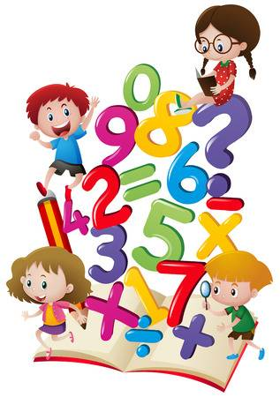

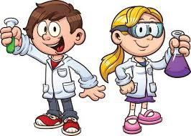


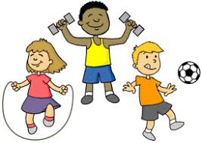
ENRICHMENT AREAS OF LEARNING
ENRICHMENT AREAS OF LEARNING
English | In reading we will be using our phonics to help us read unfamiliar words. We will also be practising reading known texts fluently and talking about stories we have read. In writing this term we will be focusing on our sentence structure, as well as using adjectives. We will have daily phonics lessons to support both reading and writing.
Maths | In Maths we will be looking at addition and subtraction, using a range of methods to support our working. We will also explore fact families and how addition and subtraction facts are related. We will then move on to looking at 2D and 3D shape.
Science | During this half term, children will be learning about everyday materials and their properties. We will focus on the differences between objects and materials and natural materials vs man-made.
Computing | This term we will explore tools for digital painting. We will then use these tools to create our own digital paintings, while gaining inspiration from a range of artists’ work.
History | In history we will be looking at the how toys have changed in the last 100 years. We will learn historical terms such as within and beyond living memory and start to explore timelines and how they can help us compare when events happened.
R.E. | In RE this term we will continue to learn about some of the key beliefs of Christians. We will look at some of the beliefs about God and Jesus. We will also look at some of the stories that shows what Christians believe about God.
DT | In art we will be learning about colour and colour mixing. We will also look at the artwork of Alexander Calder. In D.T. we will be exploring wheels and axles and will design and make our own moving vehicle.
P.E. | In PE we will be exploring the fundamentals of balancing, running and changing direction. We will be taking part in games and learning to work collaboratively.

