Slide 1

Class Curriculum Information
CLASS NOTICES
Class Text
Our class texts are: ‘Little Red’ by Bethan Woollvin, ‘It Fell from the Sky’ by The Fan Brothers and ‘Zim, Zam, Zoom’ by James Carter.
Reading
The children will read for at least 10 minutes every day in school and we hope parents will do the same at home. The children will have a levelled reader that will be changed weekly. They will also have a reading for pleasure book that they can change whenever they wish. Both can be commented on in their reading diary.
PE
PE will take place on a Wednesday and Friday.
Children may come to school in their kit on PE days. They will be wearing this kit outside at lunch and playtimes so please ensure it is weather appropriate.
Homework
Our homework will be sent out every Friday returning back into school by the following Wednesday. If you have any questions about the homework, please ask.
Please ensure your child brings in a named water bottle everyday.
Year 2
Autumn Term 1
2025/2026

Slide 2




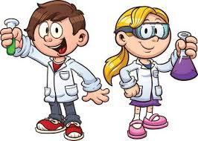

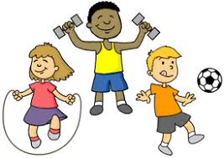

ENRICHMENT AREAS OF LEARNING
ENRICHMENT AREAS OF LEARNING
English | In reading we will be exploring poetry and looking at different ways to recite a poem, so that it is interesting for the reader. Our writing will focus on composing a sequence of correctly punctuated sentences in order to retell the key events form a known story.
Maths | In Maths we will be building on our place value knowledge by identifying the place value in 2-digit numbers. We will flexibly partition numbers into tens and ones. We will then learn how to apply this skill to help us with addition and subtraction problems.
Science | During this half term, we will Identify stages in the life cycles of different animals, including humans and describe the basic survival needs of animals. We will also learn about the importance of exercise, balanced diet and personal hygiene in order to keep our bodies healthy.
Computing | We will identify IT equipment around us. We will also be learning about E-safety and how to stay safe when using all types of technology.
Geography | In Geography, we will focus on discovering human and physical features in our local area. We will use compasses to identify North, East, South and West and use positional language to describe the location of features and routes on a map of Bretton and Peterborough.
R.E. | In RE this half term, we will be exploring the question ‘Who is a Muslim and what do they believe?’ We will learn how Muslims worship their God and compare this to our beliefs and values.
ART | In DT, we will design and create functional fairground wheel so that the wheel rotates and the structure stands freely. We will also be conducting simple surveys to gather opinions on what we need or like in a design.
P.E. | In PE we will be developing our ball skills such as throwing and catching, rolling, kicking and dribbling with both hands and feet. We we also learn how to be effective team players.

