Slide 1

Class Curriculum Information
CLASS NOTICES
Class Text
Our class text is An Alien in the Jam Factory by Chrissie Sains.
Trip
To help support our music and arts curriculum, Year 3 pupils will be going on to the New Theatre to see the production of The Snowman on Tuesday, 6th December 2025.
Reading
All children will read for at least 10 minutes every day in school and we hope parents will do the same at home. Books will be changed when children have completed an Accelerated Reading Quiz.
PE
PE will take place on a Monday and Friday. Children can come to school in their kit on PE days (shorts/leggings/jogging bottoms, plain t-shirt, trainers and jumper for outdoors).
Homework
Spellings and maths will be sent out every Friday and returned back into school by the Tuesday.
Please ensure your child brings in a water bottle, school jumper/cardigan and coat everyday.
Year 3
Autumn Term 2
2025/2026

Slide 2




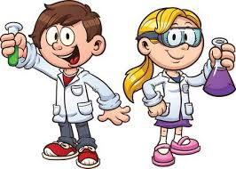


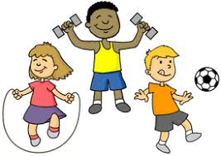
ENRICHMENT AREAS OF LEARNING
ENRICHMENT AREAS OF LEARNING
English | We will be developing writing skills by using commas in a list and exploring prepositions to describe where and when things happen. We will write setting descriptions using ambitious vocabulary and Drama for Writing, and create our own stories written in the first person, describing events from a character’s point of view.
Maths | In Maths we will be consolidating our understanding of place value in 3 & 4 digit numbers with adding and subtracting. Then, we will begin to develop our knowledge of different strategies to solve multiplication and division of 3 & 4 digit numbers.
Science | In Science this term, we will be learning about forces and how they work. The children will explore magnets and magnetism, discovering which metals are magnetic and which are not. They will also investigate friction, learning how it can slow down or stop moving objects, and how different surfaces affect the amount of friction.
Computing | During our computing lessons we will use a range of techniques to create a stop-frame animation and then apply those skills to create a story-based animation. We will also continue to learn about e-safety.
History | In history we are learning about everyday life in the Stone Age. We will explore what prehistory means and learn about the work of an archaeologist and the importance of evidence in helping us understand the past. The children will develop their understanding of chronology and how life changed throughout the Stone Age.
R.E. | In RE, we will continue to learn about religious and spiritual ways of Christians’ life in Britain. We will investigate what Christians do at home, in church and in the wider community and why their beliefs are important to them.
D.T | We will explore pneumatic mechanisms and how air can be used to create movement. They will investigate real-life examples and practise building simple systems before designing and making their own moving toy powered by air.
P.E. | Our PE will focus on developing our balance and coordination skills. We will also learn fitness supports muscle and bone growth and refuses risk of illness.

